Slide 1

Phishing Awareness Training

Slide 2
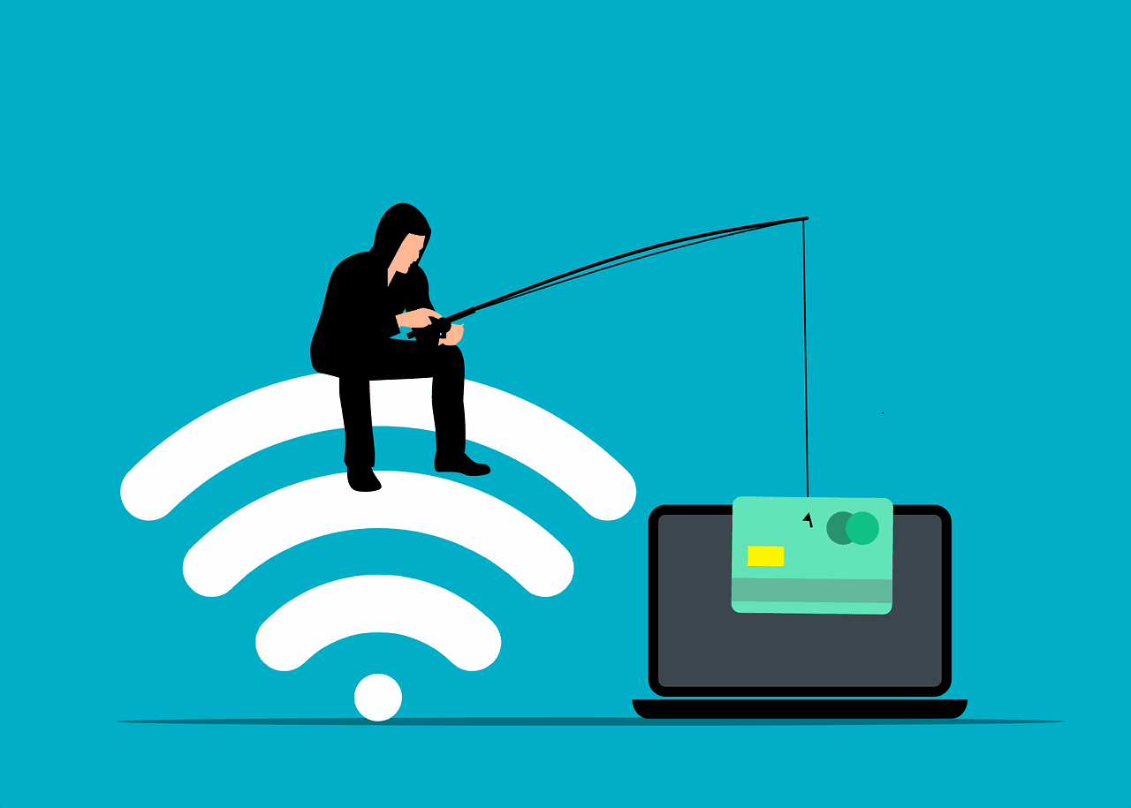
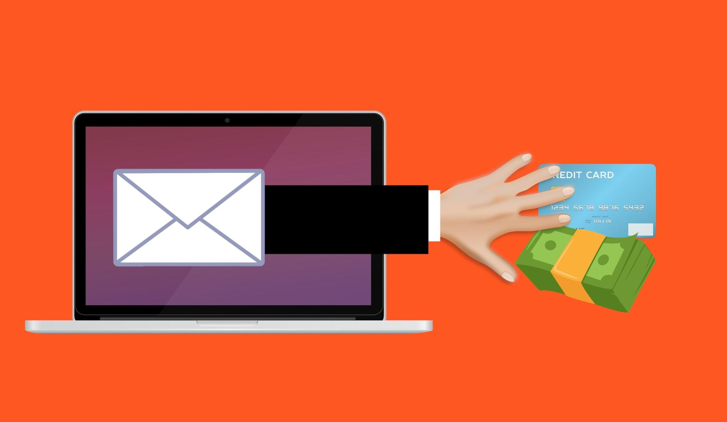
Introduction to Phishing Awareness Training
In today's digital landscape, phishing attacks are a significant threat. This training will help you understand and recognize phishing attempts, protecting your personal information. Stay informed and vigilant to safeguard yourself against these deceptive practices.

Slide 3
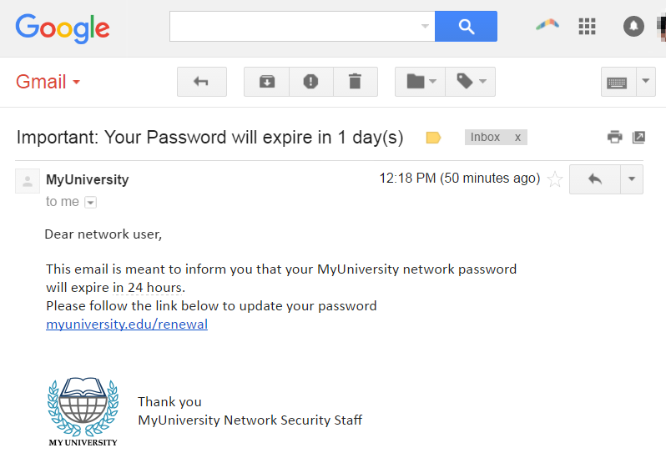
What is Phishing
Phishing is a deceptive technique used to trick individuals into sharing personal information. These attacks often involve:
Fake emails: Designed to look like legitimate communications.
Fake websites: Mimicking trusted sites to steal credentials.
Phone calls: Posing as trusted entities to gather information.
Text messages: Using SMS to lure victims into revealing data.

Slide 4
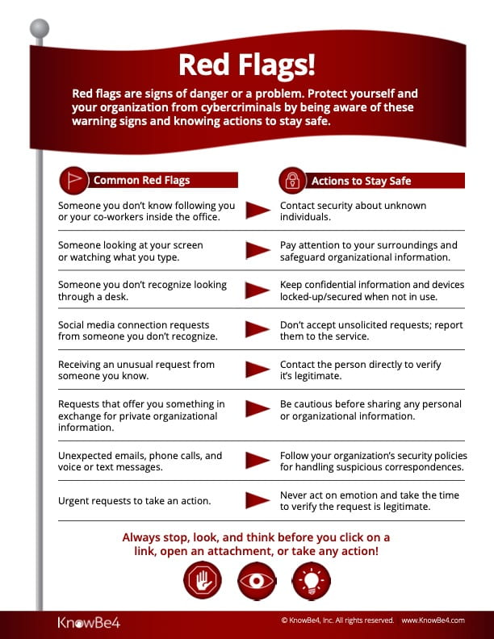
Recognizing Phishing: Red Flags
Be alert for these common red flags in phishing attempts:
Urgent tone: Creating a sense of immediate action required.
Odd sender: Unfamiliar or suspicious email addresses.
Poor grammar: Spelling and grammatical errors.
Suspicious links: Links that don't match the sender's official website.

Slide 5
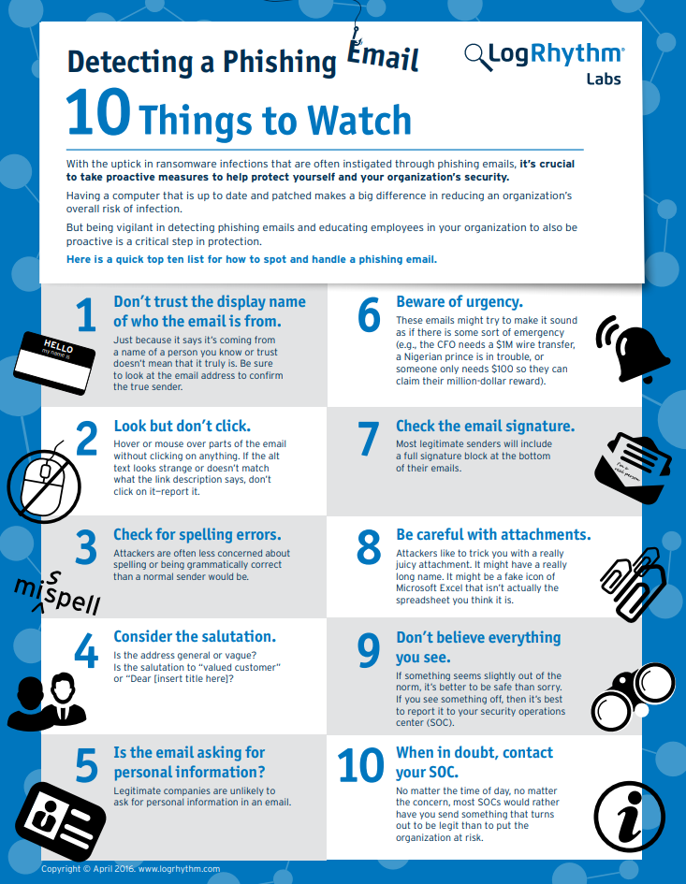
Tactics Used in Phishing
Phishers employ various tactics to deceive their victims:
Impersonating authority figures: Posing as someone in a position of power or trust.
Creating a sense of urgency: Pressuring individuals to act quickly without thinking.
Offering fake rewards: Promising prizes or incentives to lure victims.
Look-alike URLs: Fake sites often use look-alike URLs (e.g., paypa1.com).

Slide 6
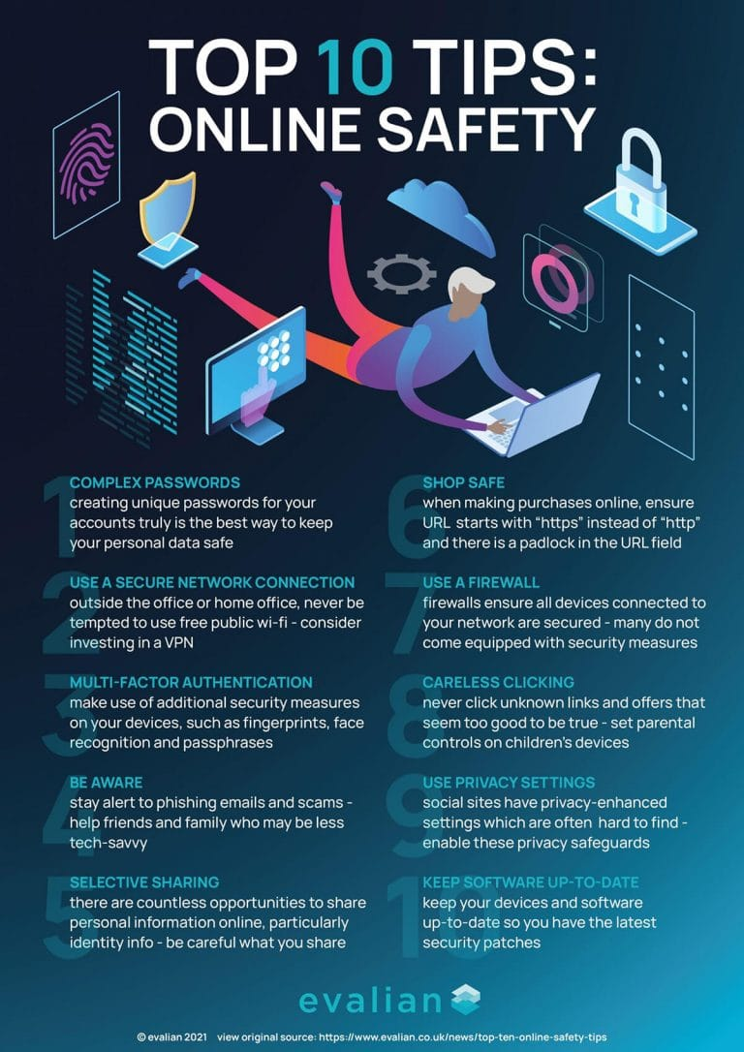
Staying Safe Online
Protect yourself from phishing attacks with these practical tips:
Avoid shady links: Don't click on links from unknown or suspicious sources.
Verify senders: Confirm the sender's identity through official channels.
Use Multi-Factor Authentication (MFA): Add an extra layer of security to your accounts.
Update software: Keep your software and operating systems up to date with the latest security patches.
Report scams: Alert authorities and relevant organizations about phishing attempts.

Slide 7
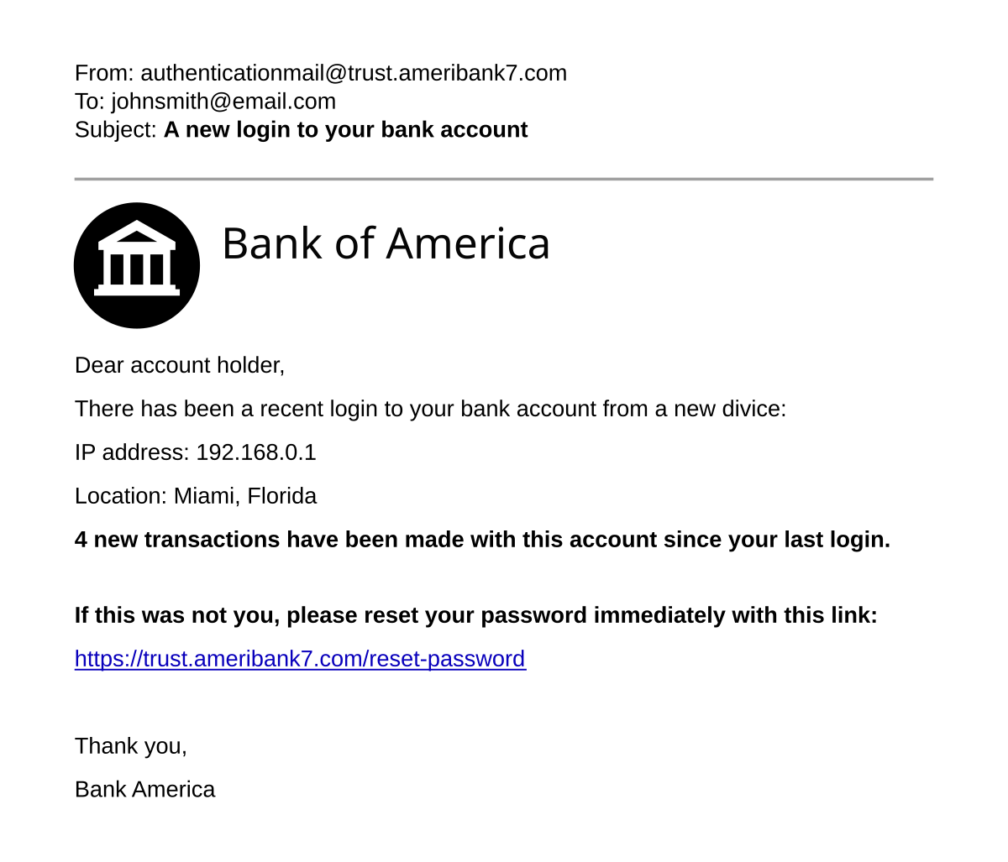
Real-World Examples of Phishing
Phishing attacks can take many forms and target various individuals and organizations:
Election hacks: Attempts to influence elections through phishing campaigns.
Nigerian Prince emails: Classic scam promising large sums of money in exchange for personal information.
COVID-19 related scams: Exploiting the pandemic to steal personal and financial data.

Slide 8
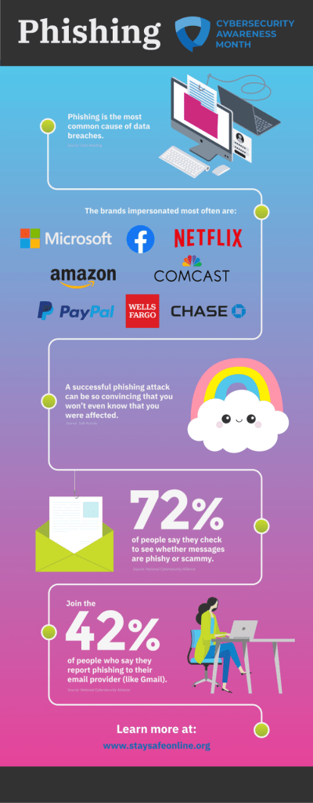
The Phishing Response: Recognize, Verify, Report
Follow this three-step response to handle potential phishing attempts:
Recognize: Identify the red flags and signs of a phishing attack.
Verify: Confirm the source's legitimacy through official channels.
Report: Alert the appropriate authorities or organizations about the scam.

Slide 9
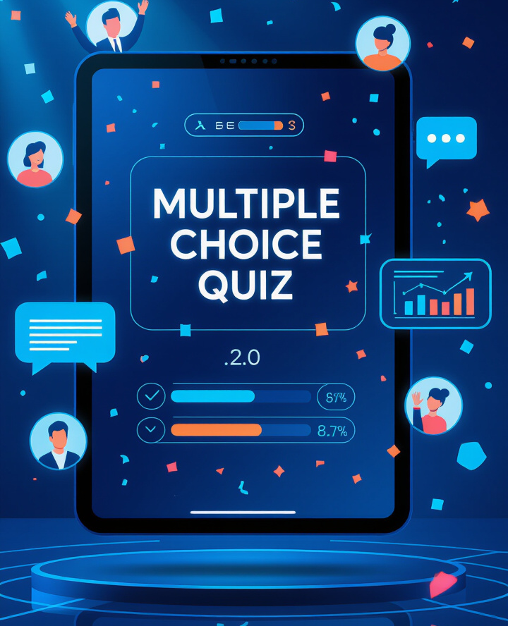
Interactive Quiz (for audience engagement)
Utilize interactive quizzes to boost audience engagement. Incorporate multiple choice questions to create an interactive experience that captivates your audience.
1. You get an email from support@paypa1.com asking for your login details. What should you do?
A) Reply with your details
B) Delete and report it
C) Click the link and check
2.True or False: If a website has HTTPS, it’s always safe. False. HTTPS helps, but fake sites can also use it.
3,What’s the first thing you should check in a suspicious email? The sender’s email address and the message tone.

Slide 10
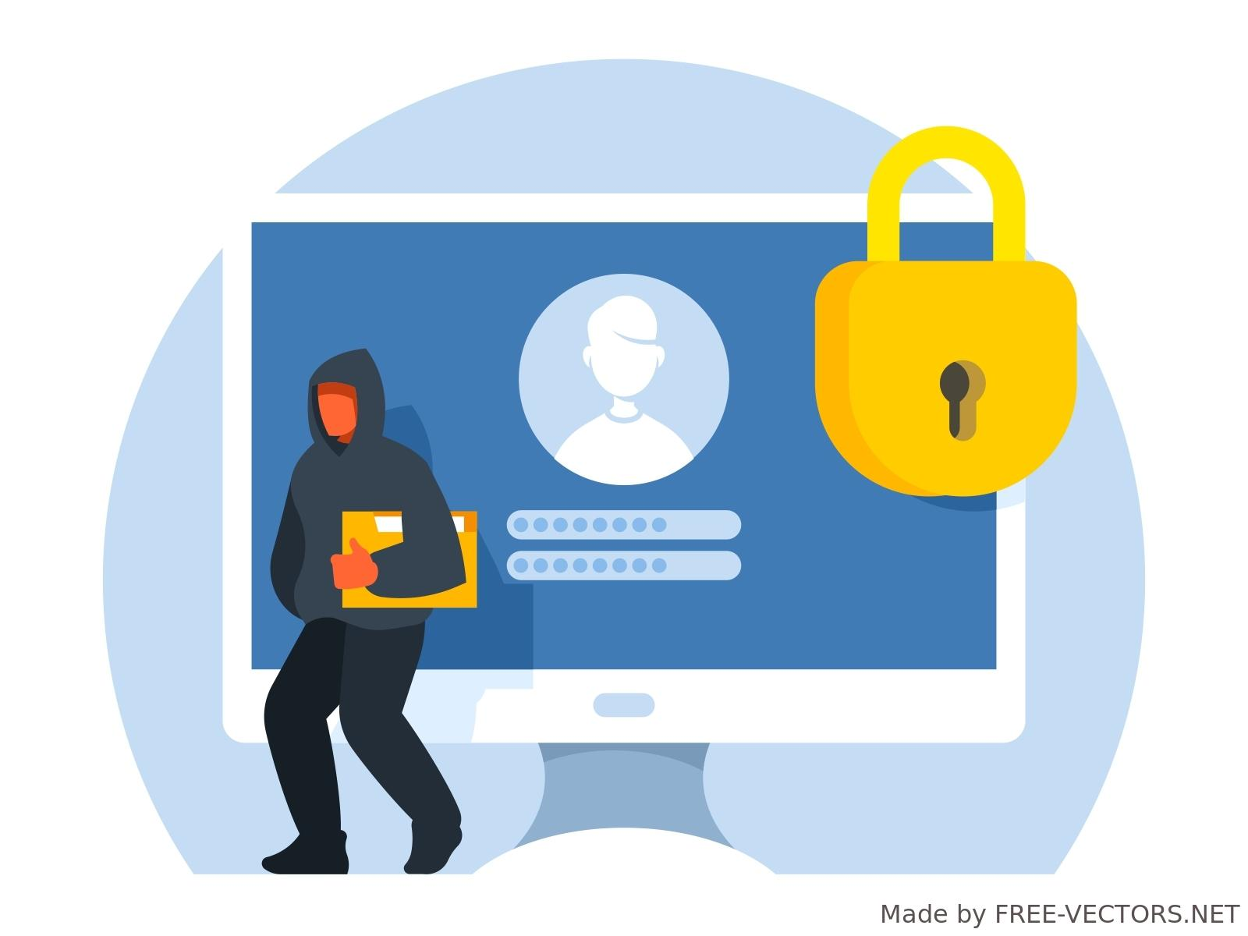
Conclusion: Think Before You Click
Always think critically before clicking on links or sharing information online. Vigilance and awareness are your best defenses against phishing attacks.

